Slide 1
NGS - adatelemzés
Dr. Ligeti Balázs
2019. április 10.

Slide 2
Miről lesz szó?
Short recap
Assembly feladat és problémája
De Bruijn-graph
Mutációelemzés
Metagenomika
Antitest repertoár jellemzés
DNS-IP-seq

Slide 3
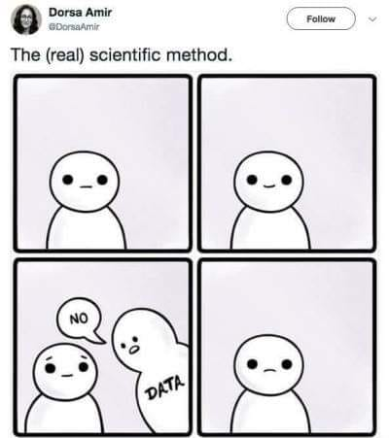

Slide 4
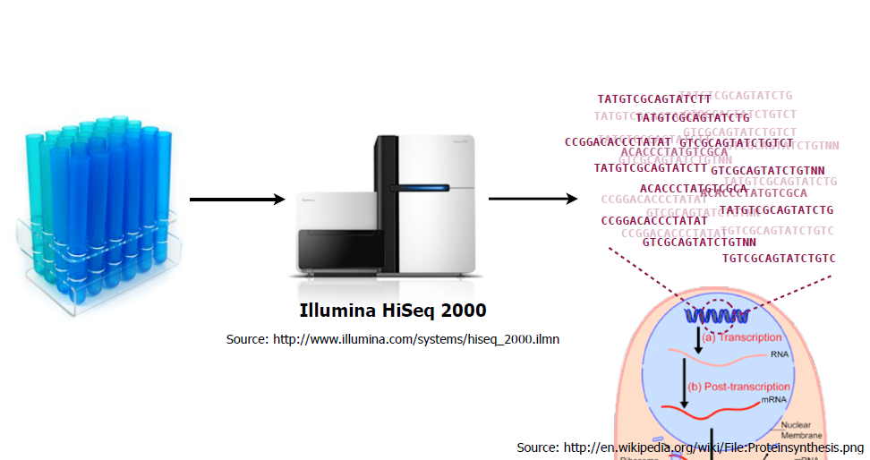
Szekvenálás

Slide 6
Sequence assembly
INTRO
Overlap: find potentially overlapping reads
Layout: merge reads into contigs, and
contigs into supercontigs
Consensus: derive the DNA sequence and correct read errors
..ACGATTACAATAGGTT..

Slide 7
The mathematical problem
INTRO
We start with millions of DNA reads, 200 bases each
Multiple copies of DNA provide multiple coverages by reads
The problem of genome assembly is to recover the original sequence of bases of the genome (as much as possible…). There is generally no other information available.
Notes:
7

Slide 8
New computing solution:
Graphs (networks)
Graph: nodes and edges. “Network”: very large graphs
Hamilton path: pass each node once. NP complete (very hard problem)
Euler path: pass each edge once. Easy to solve

Slide 9
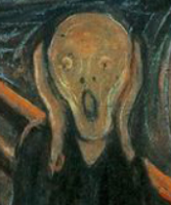
Problems:
Alas, the problem is NP-hard!
The genome (from which the reads come) is a Hamiltonian path in the graph.
Finding a Hamiltonian path is an NP-hard problem.
But, we can find an alternative representation of the graph where we will look for Euler paths, which are not NP hard but O(E) - O(E²) .
The Scream
Pevzner et al.

Slide 10

The way out 1: De Bruijn graphs
“k-mer network”
De Bruijn graphs in mathematics are built from sequences of the same length (“k-mers”) from a long text (In bioinformatics: “sliding window”).
Each k-mer window is connected to the next window. This gives a directed graph.
The graph has one unique long path: the text itself, i.e. the genome..
So, we can use relatively inexpensive approximations to finding the genome string (Euler walk finding)
Finding an Euler walk is not NP hard, complexity is proportional with the sum of the numbers of edges and nodes. (The equivalent Hamiltonian problem would be NP hard)

Slide 11
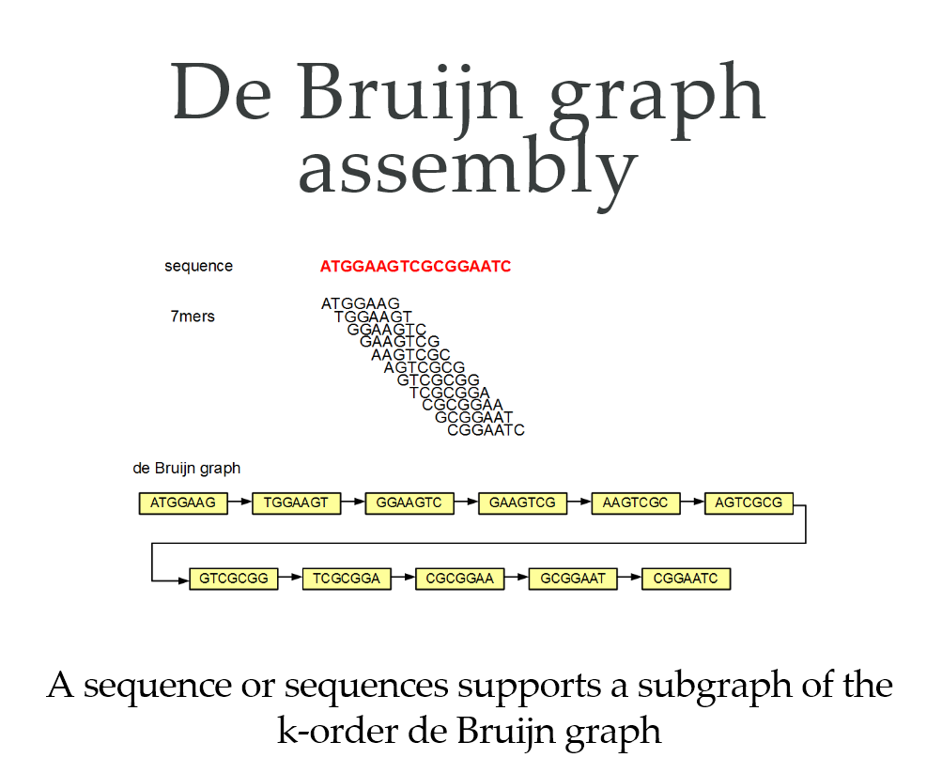

Slide 12
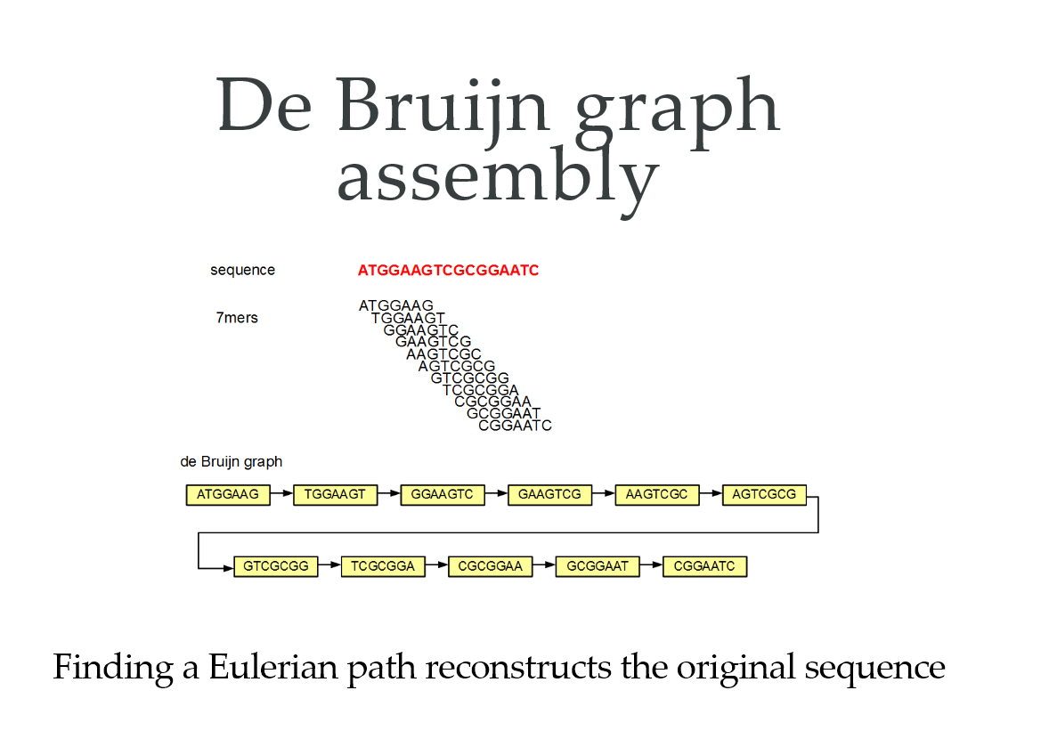

Slide 13
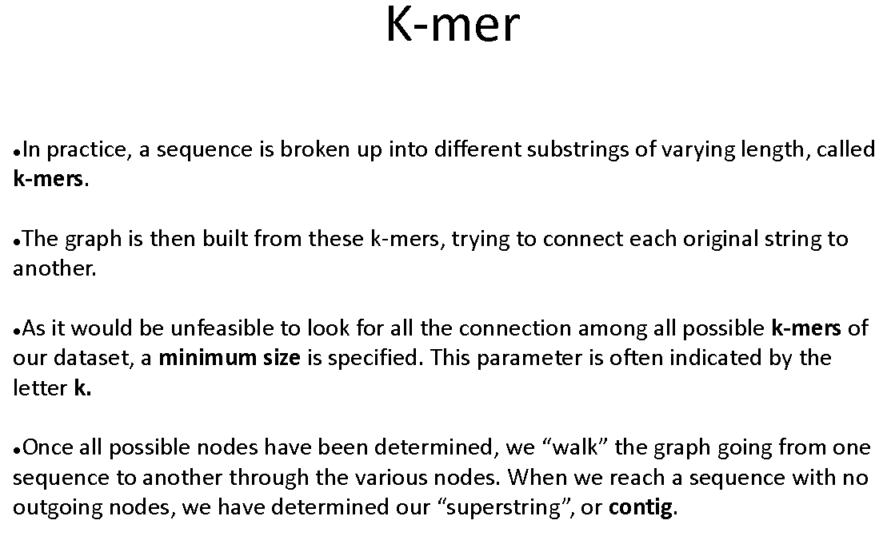

Slide 14
De Bruijn graphs:
Alas, the way out is almost lost!
Reads contain errors
Overlaps can be very short, at times even missing..
Reads from different strands
Repeats in genomes (eukaryotes)
Missing sequences (that result in scaffolds)
Huuuuuge numbers of reads
The Scream
All this makes the use of graph algorithms difficult…

Slide 15
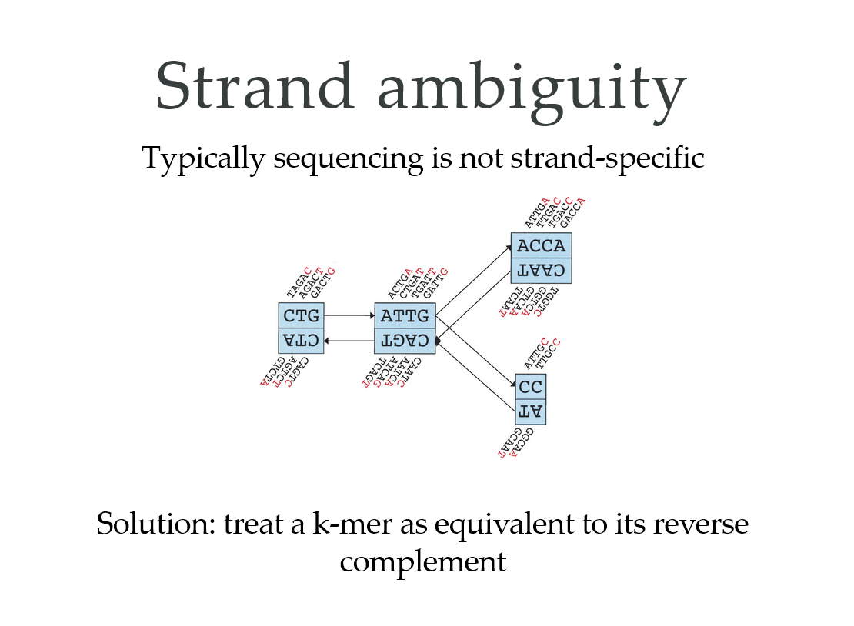

Slide 16
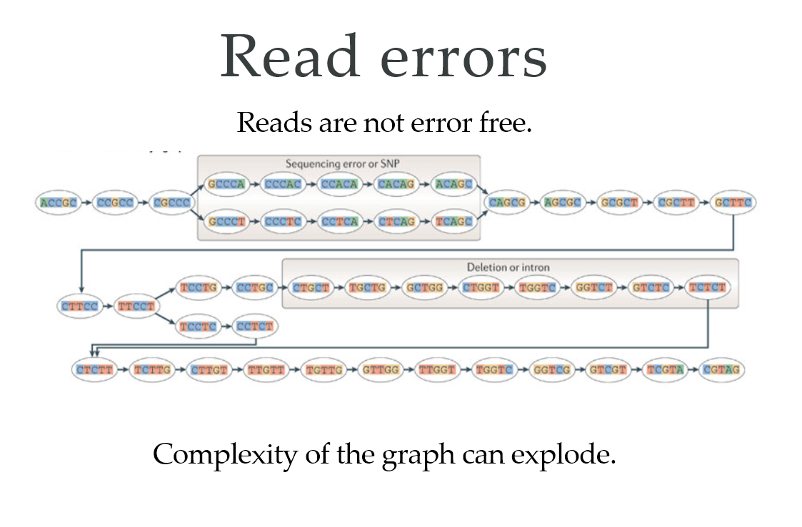

Slide 17
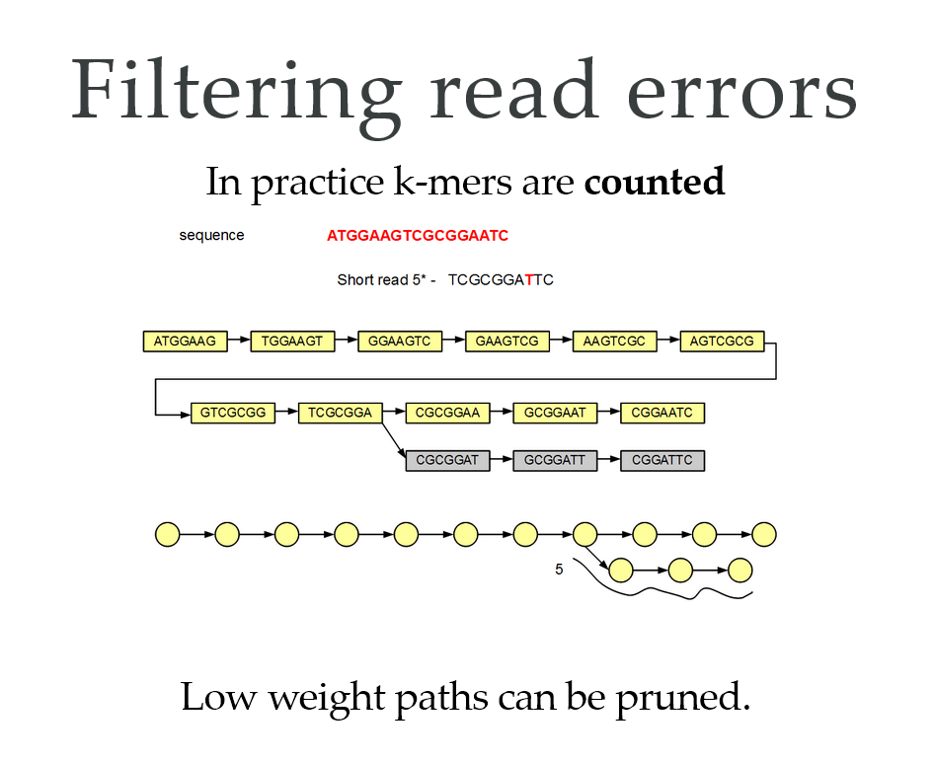

Slide 18
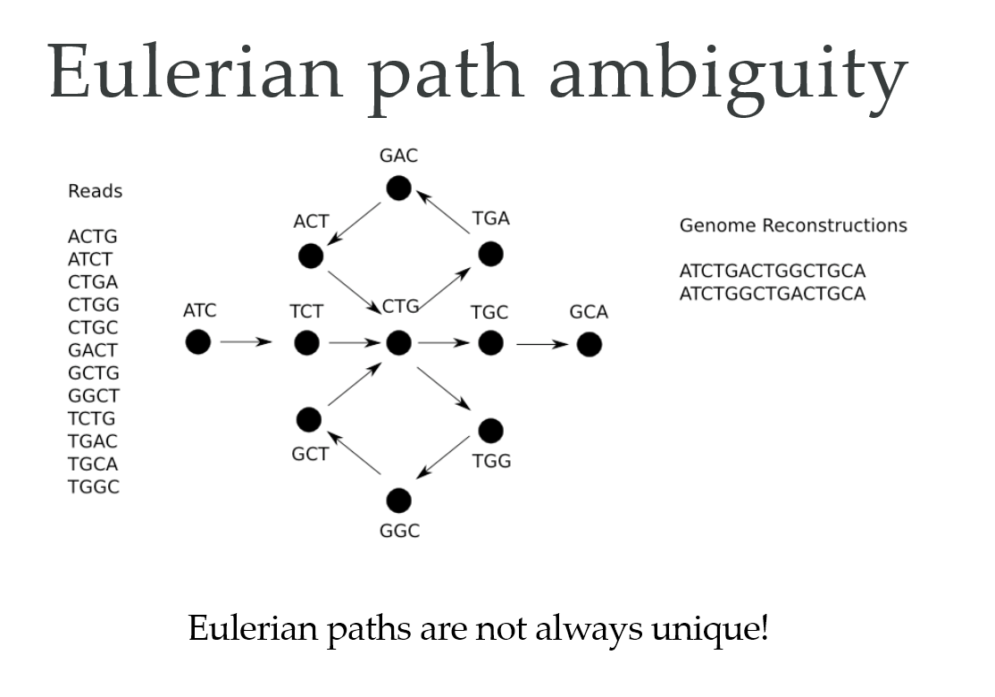

Slide 19
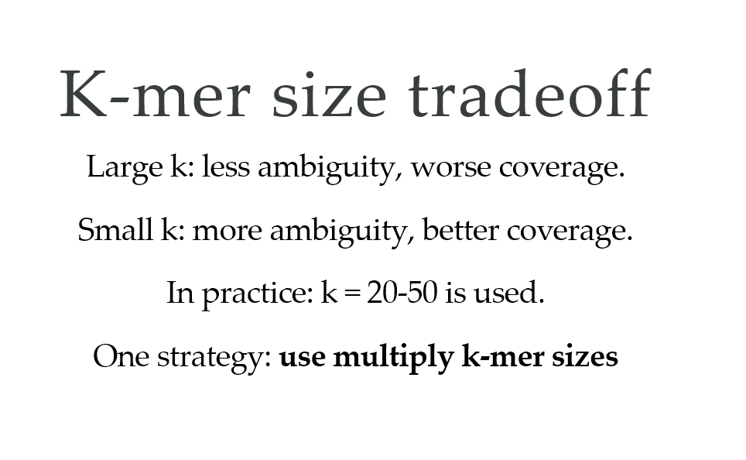
One possible strategy: use multiple k-mer sizes
Pevzner: SPADE program

Slide 20
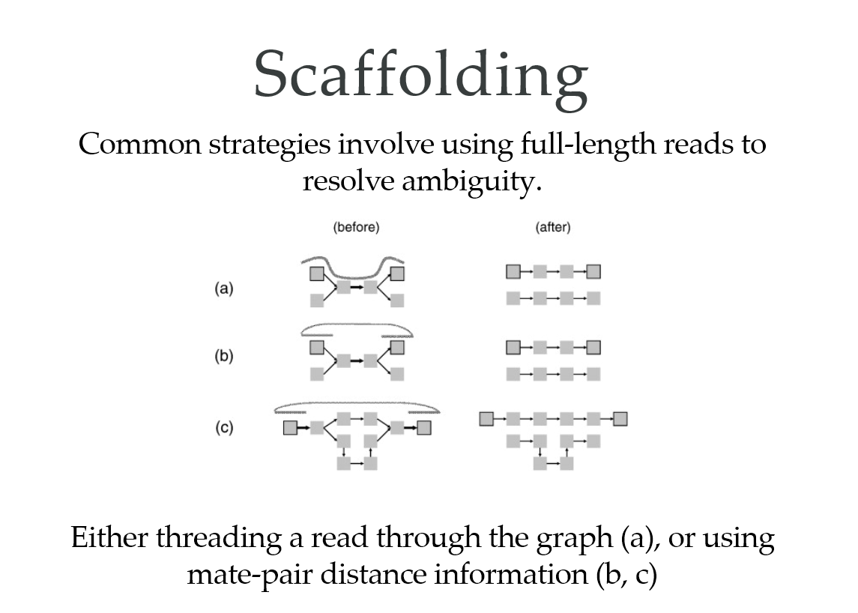

Slide 21
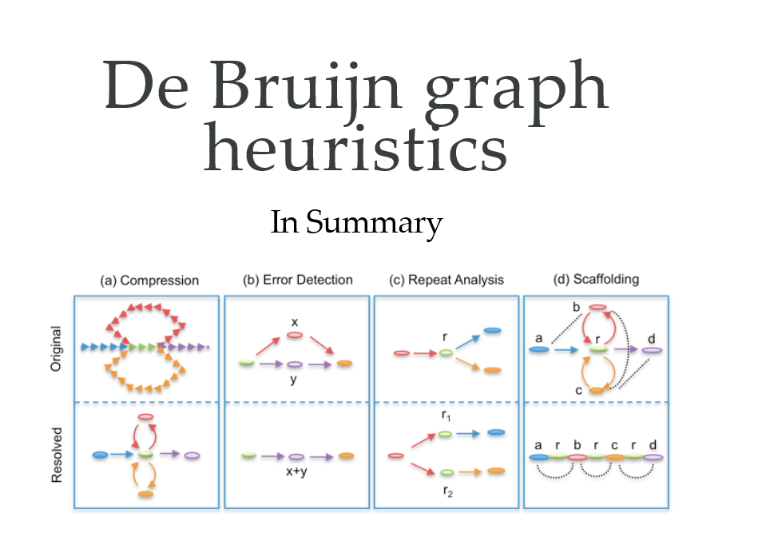

Slide 22

Summary
Assembling genomes (or contigs) from reads is a special problem composed of laboratory and computing tricks.
Sequencing strategies differ in the length and the accuracy of the reads.
Early assembly solutions rely on accurate long reads (Sanger), exhaustive comparison (Smith Waterman or similar), and a jigsaw puzzle like assembly.
Current solutions rely on large numbers of highly redundant and error-laden short reads (NGS) as well as network representations (De Bruijn graphs, overlap graphs) that avoid the need for direct comparisons such as SW.
Basic vocab

Slide 23
Variant calling
Milyen mutációk és variációk vannak?
Szomatikus vs. szerzett mutációk
Hogyan lehet ezeket azonosítani?
Pipeline példa: GATK folyamat (kvázi sztenderd)

Slide 24
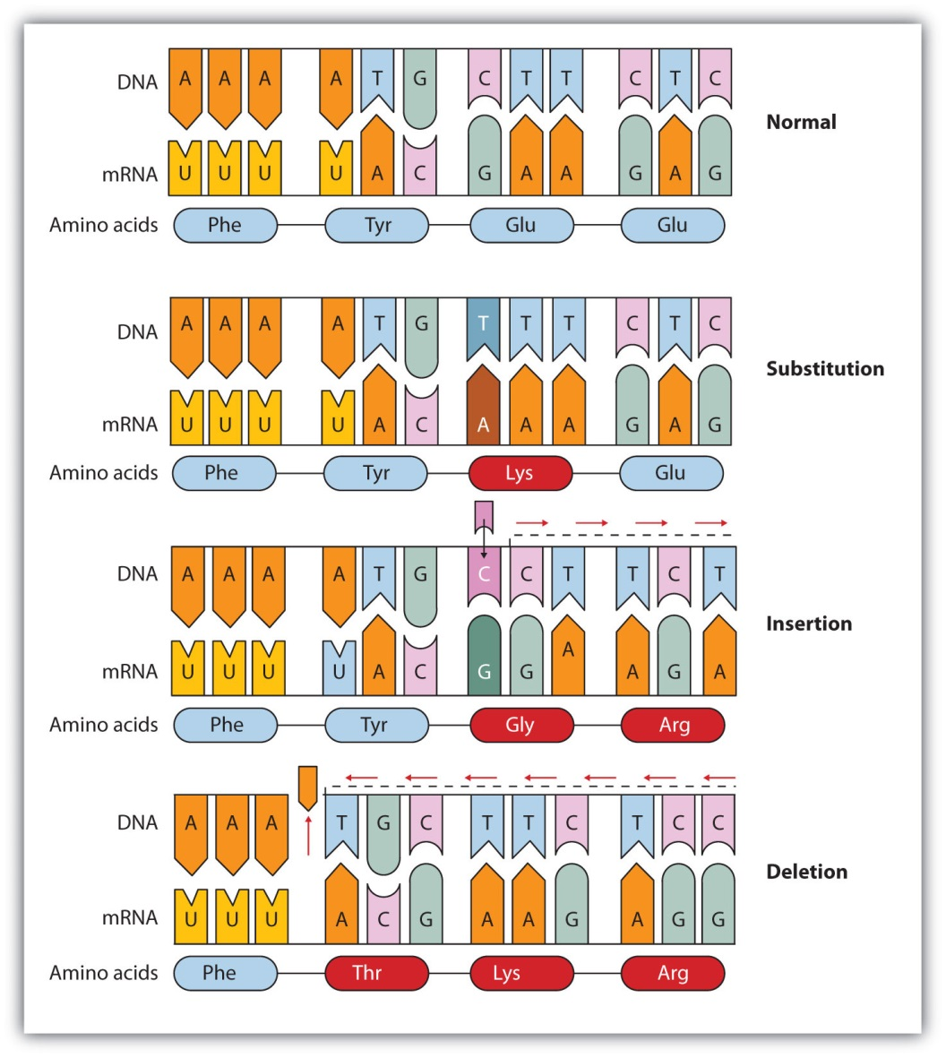
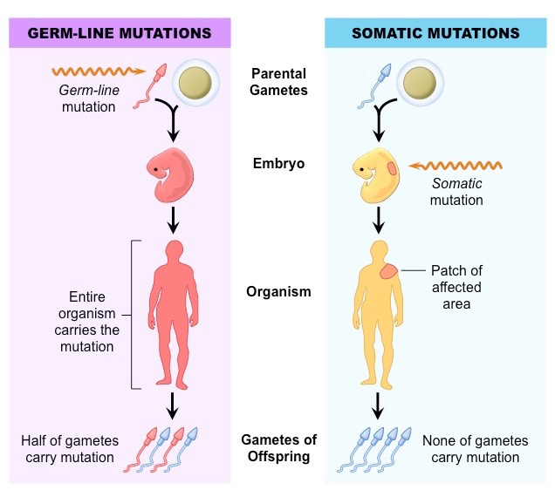
Mutations

Slide 25
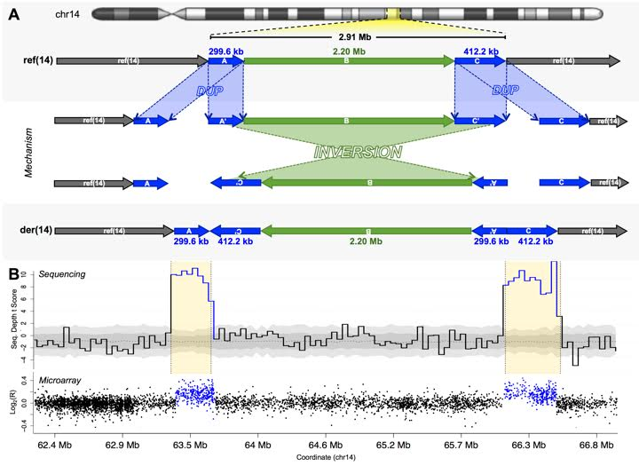
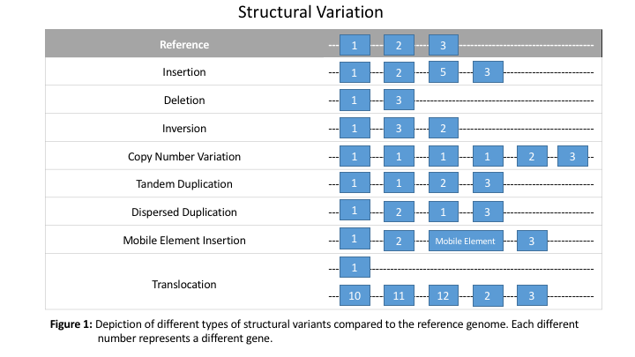
Structural variation

Slide 26
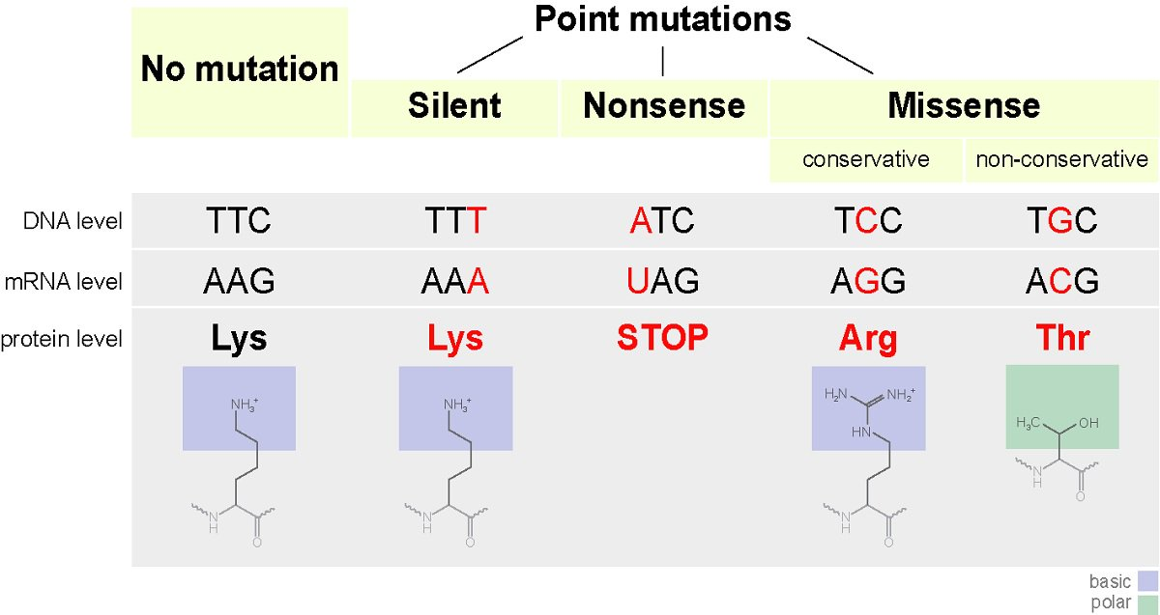
Point mutations

Slide 27
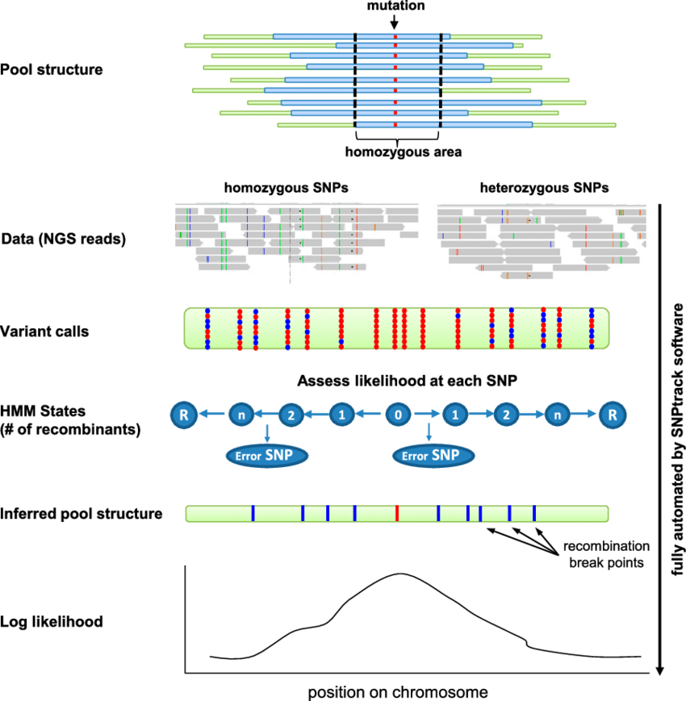
Homozygous vs heterozygous mutations in NGS data

Slide 28
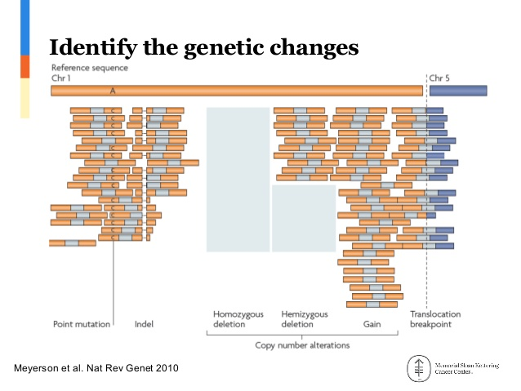

Slide 30
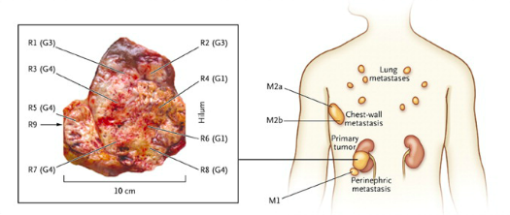
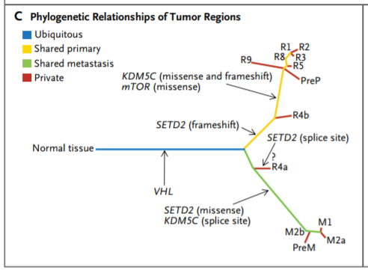
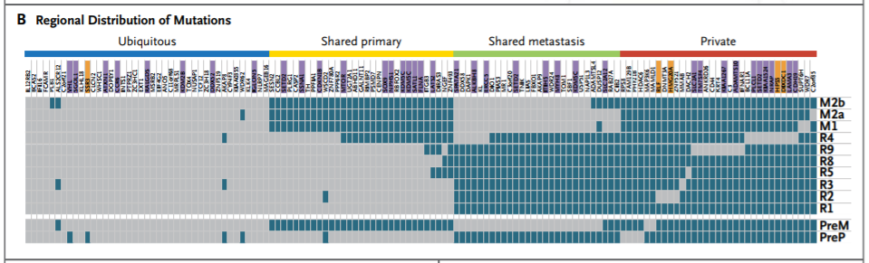
Spatial heterogeneity
Multiple studies: Renal cell carcinoma, lung cancer, ovarian cancer, colorectal cancer, breast cancer
Different regions of one tumor → different mutations
ccRCC (2012, NEJM)

Slide 31
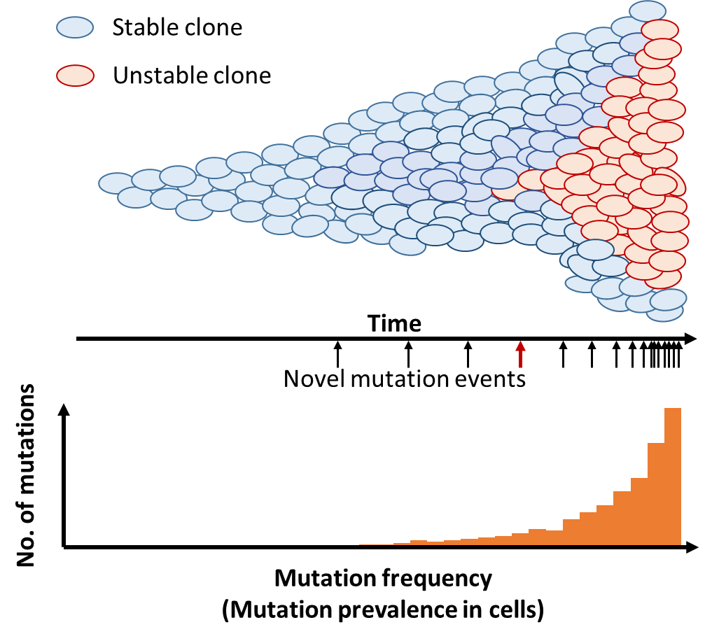
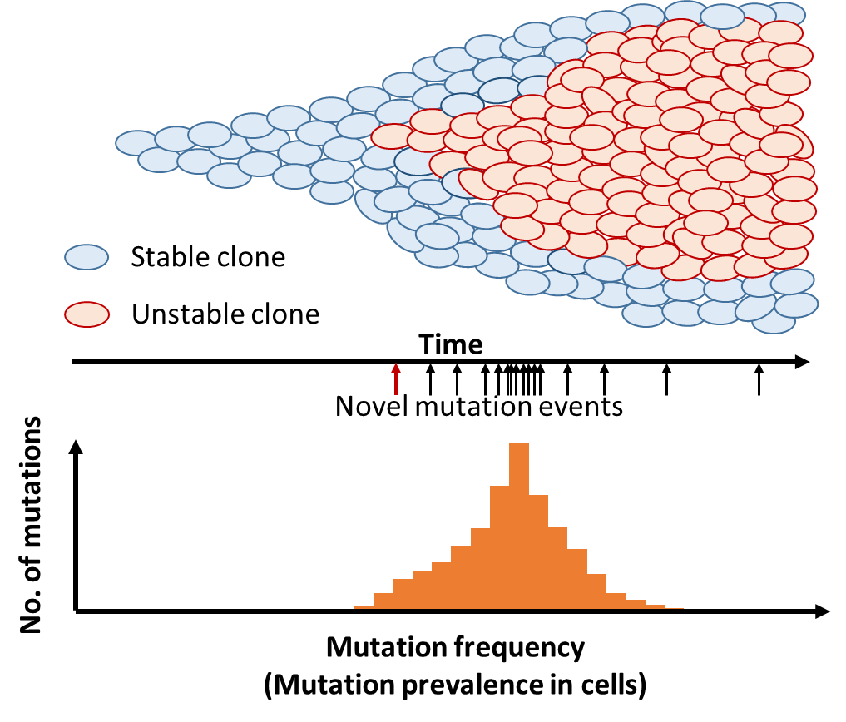
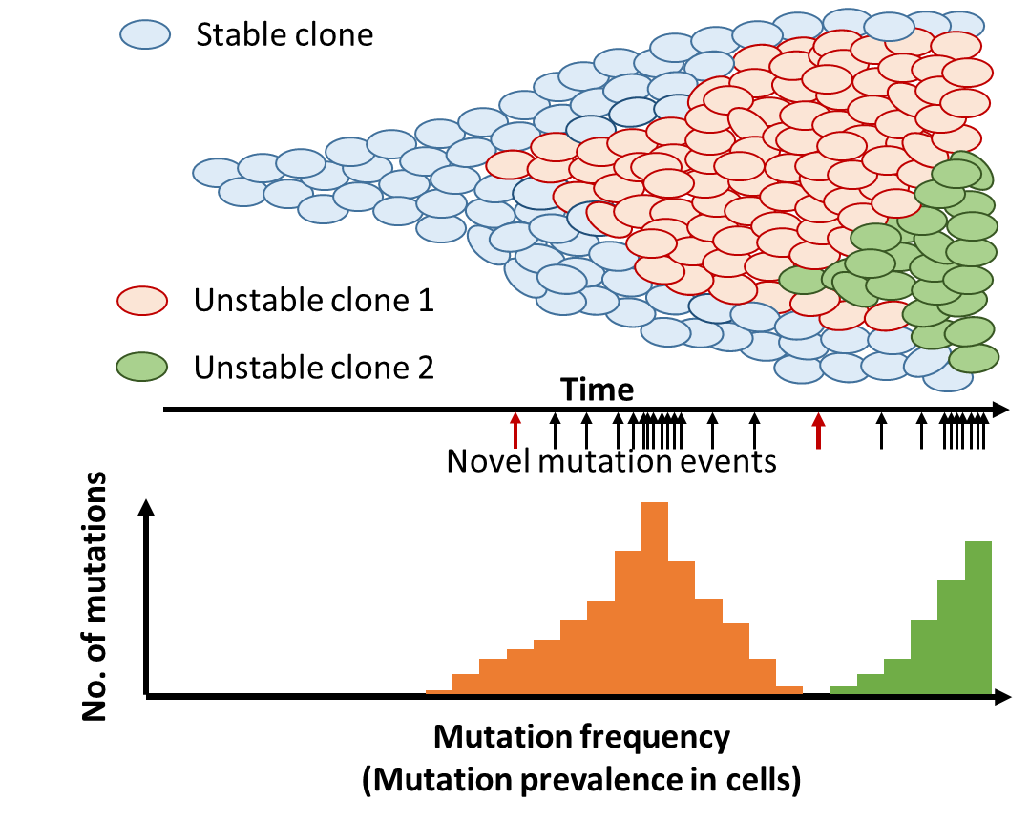
Tumor evolution
Tumor are genetically heterogeneous
Sequencing data has noise (signal/noise)
A tumor has normal cell „contamination”
Mutations not present in normal tissue
Relevant mutations can have:
    <10% mutation frequencies

Slide 32
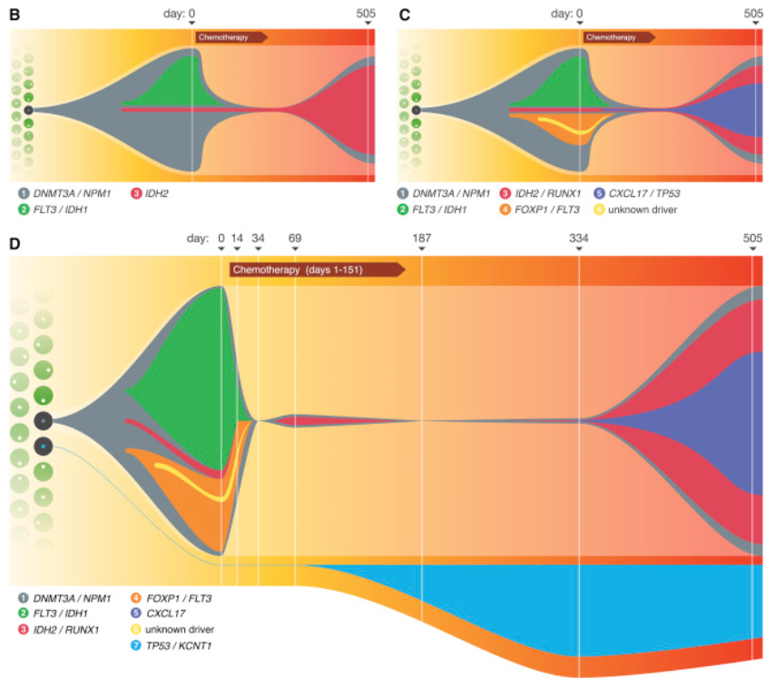
Evolution
Tumors are genetically heterogeneous
Drug treatment
Selecting resistant clones

Slide 33
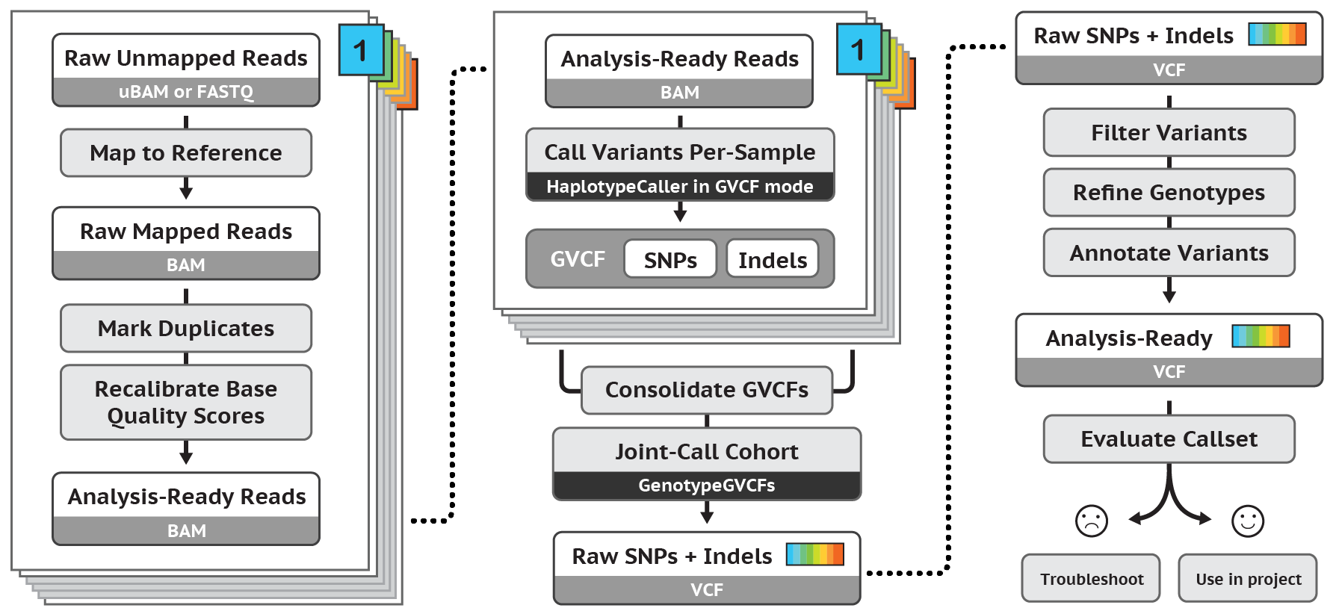
GATK

Slide 34
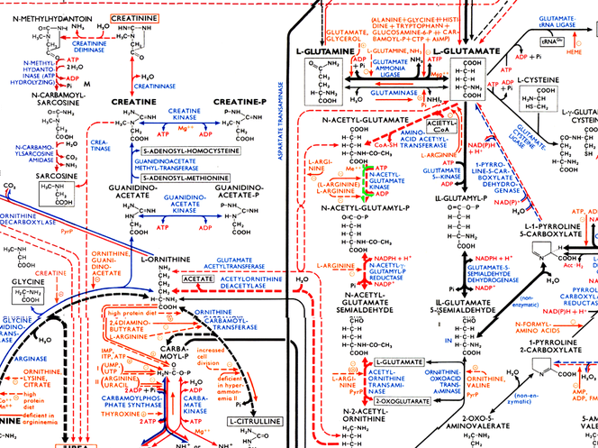
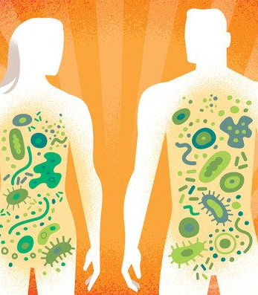
Microbes to metagenomics
Metabolic potential
Form communities
They cooperate

Slide 35
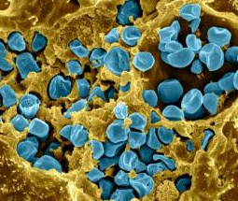
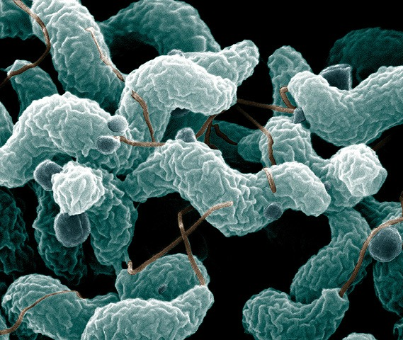
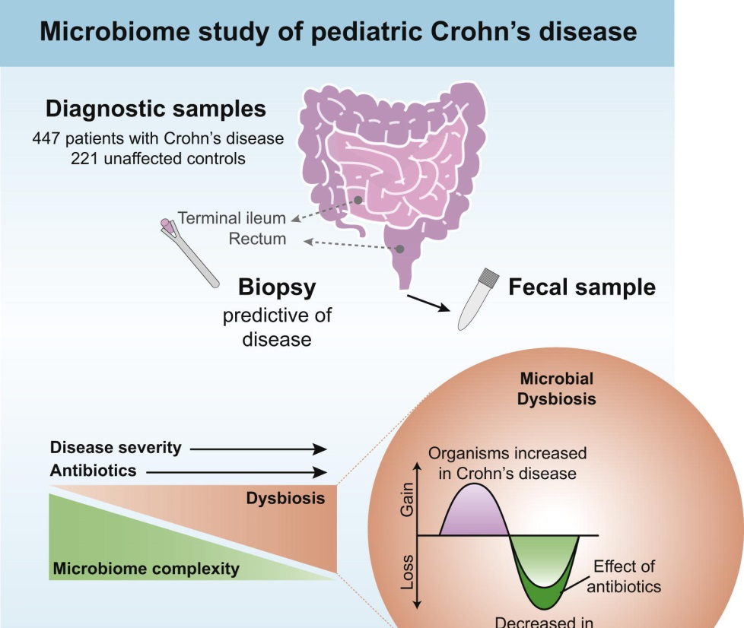
Role in Diseases
Dysbiosis
Mechanims are often not known, only associations
Pathogens (i.e. bacillus anthracis)
Food safety

Slide 36
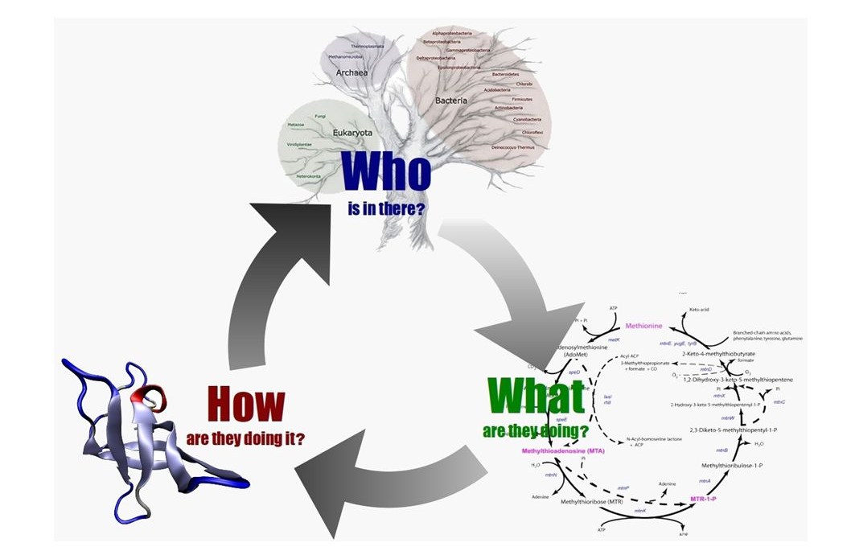
Questions on microbiomes

Slide 37
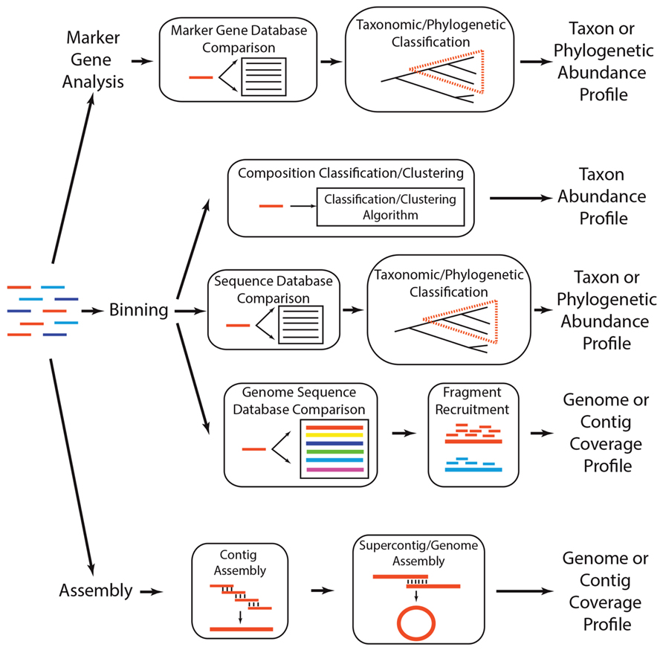
Computational approaches
https://doi.org/10.3389/fpls.2014.00209
Notes:
Two apprioach: classify each read (good database)
Genome assembly:

Slide 38
Acknowledgement
Pongor Sándor, Juhász János diái alapján
Ben Langmead (JHU, computer science)
Pongor Lőrinc

