Slide 1
ENZIMOLOGY

Slide 2
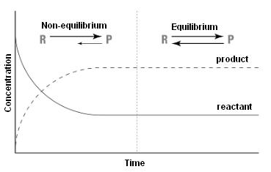
Spontaneous or non-spontaneous
The direction of the reactions determined by
the direction of decrease of the free enthalpy
A + B → C + D
ΔG < 0 exergonic
ΔG > 0 endergonic

Slide 3
Free energy of chemical reactions
A + B
C + D
If K=1, then ΔG°= 0

Slide 4
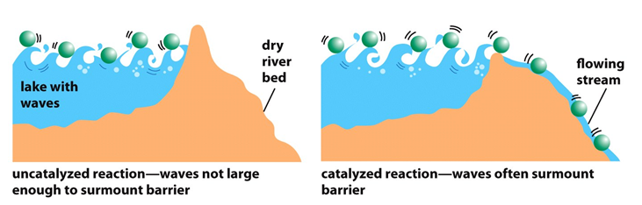
Catalizator model

Slide 5
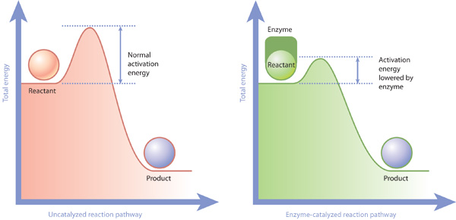
Enzymatic acceleration of chemical reactions by decreasing the activation energy

Slide 6
Coupled reactions
Termodinamically favored and non favored reactions
Exergonic reactions (with negative ΔG): spontaneous, occur without any energy investment
Endergonic reactions (with positive ΔG): do not occur spontaneously
It can occur if an exergonic reaction is coupled to it and the cumulative ΔG is negative

Slide 7
Enzymes
Catalizators:
Lowering the activation energy
Don’t change the equilibra or the free-energy change
Affect (accelerate) reaction rates
(High) specificity
Mostly proteins (some of them are RNA-s)
Coenzymes, prosthetic groups,
metal ions

Slide 8
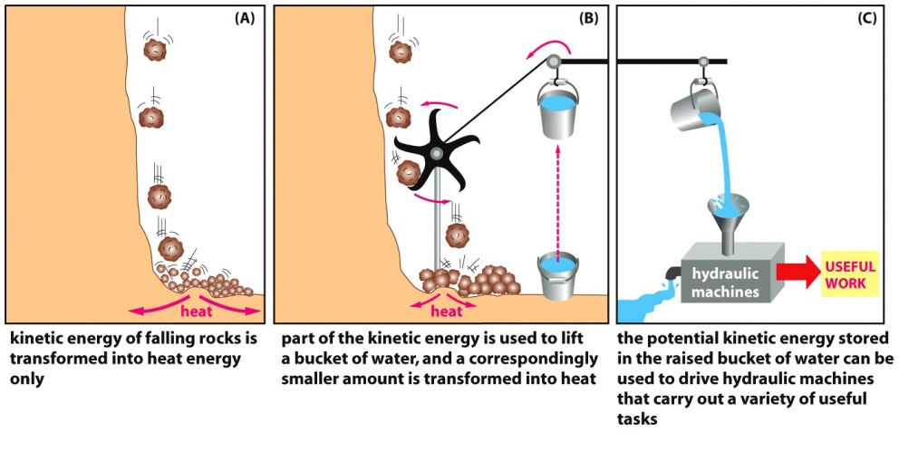
Coupled reactions

Slide 9
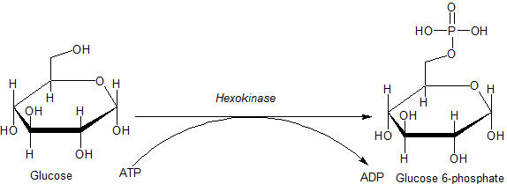
Coupled reaction of glucose phosphorylation and ATP hydrolysis by hexokinase

Slide 10
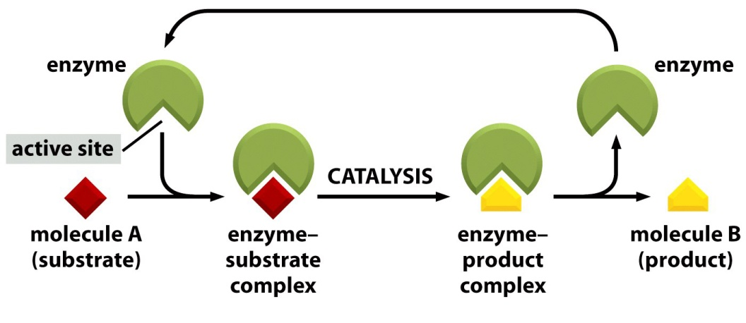
Binding site, active site
Active site: a pocket on the enzyme, where the enzyme-catalyzed reaction takes place
Substrate: The molecule that is bound in the active site and acted upon by the enzyme

Slide 11
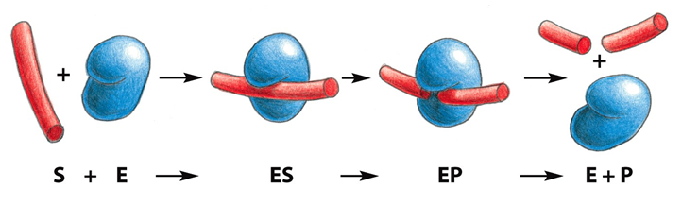
Substrates and products
Binding site, active site

Slide 12
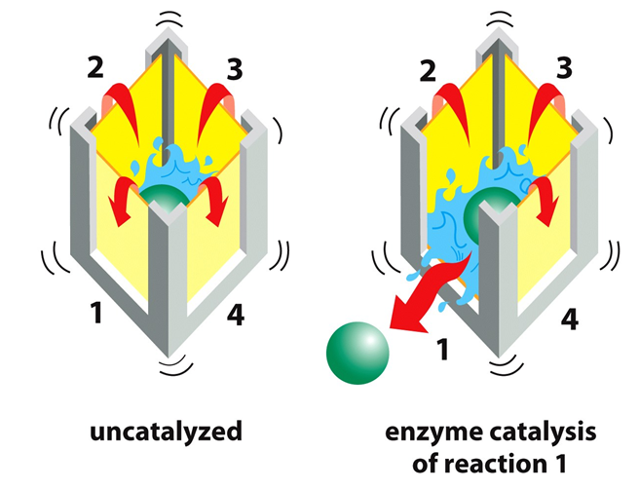
Specific enzyme catalysis
of the chosen reaction

Slide 13
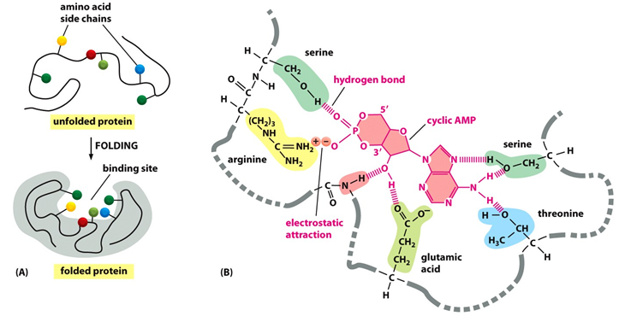
Specificity of enzymes

Slide 14
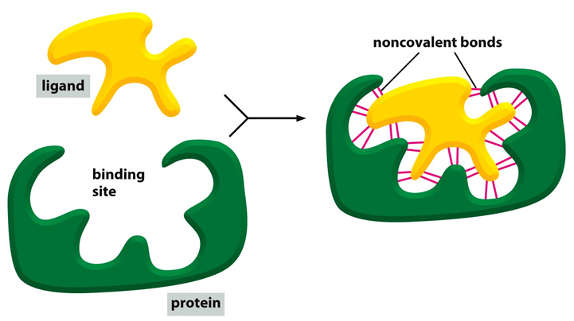
Formation of enzyme-substrate complex
The lock-and key theory: the substrate is exactly fits into the pocket of the enzyme, just like the key into the lock. Emil Fischer 1890

Slide 15
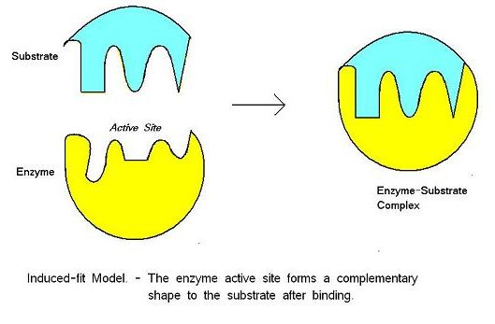
Formation of enzyme-substrate complex
Induced fit theory: the binding of the substrate induce
a change in the protein structure of the enzyme
Koshland1958

Slide 16
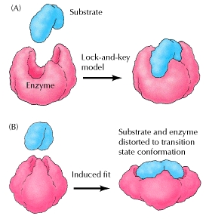

Slide 17
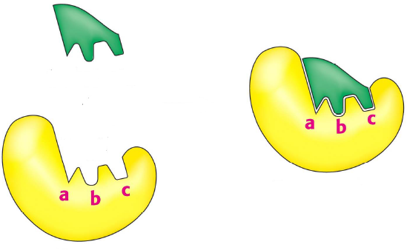
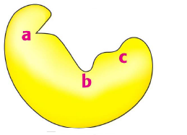
Formation of enzyme-substrate complex
The „fluctuation fit” model
substrate
active
site
inactive
site

Slide 18
Enzyme Kinetics
The rate of an enzymatic reaction and how it changes in response to changes in experimental parameters
Key factor affecting the rate: concentration of substrate, [S]
Enzyme concentration: ~ nanomolar quantities
[S]: milimolar (five or six orders of magnitude higher).
If only the beginning of the reaction is monitored (often the first 60 seconds or less), changes in [S] can be limited to a few percent and [S] can be regarded as constant.
V₀ can then be explored as a function of [S], which is adjusted by the investigator.

Slide 19
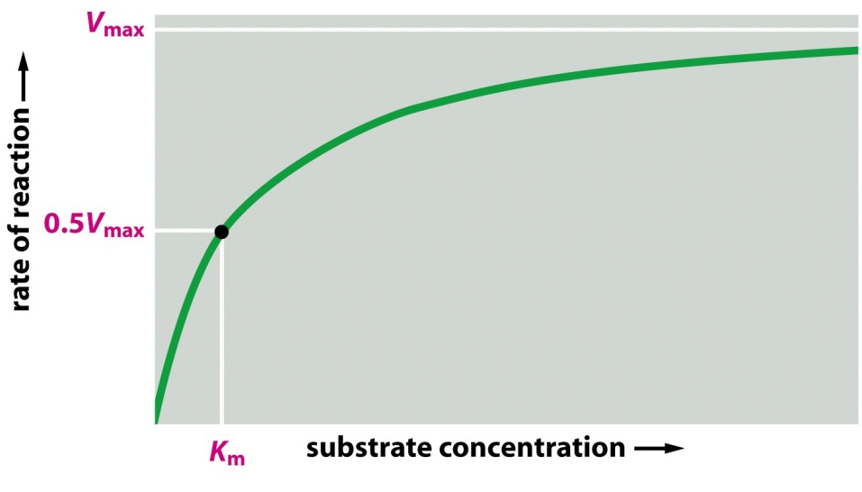
At relatively low [S]: V₀ increases almost linearly with an increase of [S].
At higher [S]: V₀ increases by smaller and smaller amounts in response to increases of [S].
Finally, a point is reached beyond which increases in V₀ are vanishingly small as [S] increases. This plateau-like V₀ region is close to the maximum velocity, V_{max}.

Slide 20
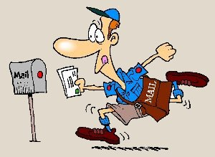
Two postmen deliver 250 letters in an hour

Slide 21
How many letters can be delivered by four postmen in an hour?
The conditions are same.

Slide 22
v_{max3} = k₂E₀₃
velocity
v_{max2} = k₂E₀₂
v_{max1} = k₂E₀₁
concentration of substrate

Slide 23
What do the kinetical parameters tell us?
v_{max}: It is proportional with the amount of enzyme. Essentially it gives the activity of the enzyme. It serves information on the amount of enzyme.
It depends on the amount of enzyme (protein), it is not an enzyme feature
The k₂ speed constant is an enzyme feature
v_{max3} = k₂E₀₃
velocity
v_{max2} = k₂E₀₂
v_{max1} = k₂E₀₁
concentration of substrate

Slide 24
The rate of enzymatic catalysis
The velocity (v) can be calculated by multiplying the
concentations by the kinetic constant (k):
A+B
k₁
AB
v₁=k₁·[A]·[B]
k₂
v₂=k₂·[AB]
At the beginning of S→P transformation:
k₁
k₃
E+S
ES
E+P
v=k₃·[ES]
k₂
[E_{t}]=[E]+[ES]
When the substrate-concentration is really high,
all the enzymes are working. A this state:
V_{max}=k₃·[E_{t}]

Slide 25
The rate of enzymatic catalysis
v
k₃·[ES]
[ES]
=
=
V_{max}
k₃·[E_{t}]
[E_{t}]
Since the stacionary state of the reactioni is formed
really fast, the [ES] considered to be constant. Now:
k₁·[E]·[S]=k₂·[ES]+k₃·[ES]
=
(k₂+k₃)·[ES]
[E]·[S]
[E]·[S]
[ES]
=
[E_{t}]=
+[E]
k₂+k₃
K_{m}
k₁
K_{m}

Slide 26
The rate of enzymatic catalysis
[E]·[S]
[S]
v
K_{m}
K_{m}
[S]
=
=
=
V_{max}
[E]·[S]
[S]
K_{m}
[S]+K_{m}
+[E]
+
K_{m}
K_{m}
K_{m}
[S]·V_{max}
v =
Michaelis-Menten equation
[S]+K_{m}

Slide 27
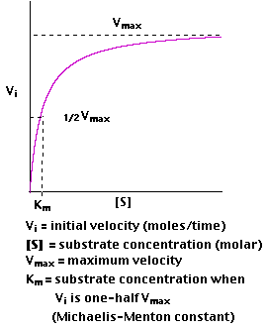
Reaction velocity at start
In theory, reaching V_{max} is impossible
But, in a special case:
V_{max}
v =
Ekkor:
2
V_{max}
[S]·V_{max}
=
2
[S]+K_{m}
1
[S]
=
2
[S]+K_{m}
[S]+K_{m} = 2·[S]
K_{m} = [S]
In this case,
K_{m} numerically
equals to [S]

Slide 28
Reaction velocity at start
Let us use the reciprocal equation for better
illustration and calculation
1
[S]+K_{m}
[S]
K_{m}
=
=
+
v
[S]·V_{max}
[S]·V_{max}
[S]·V_{max}
1
K_{m}
1
1
=
·
+
v
V_{max}
[S]
V_{max}
y
a
x
b

Slide 29
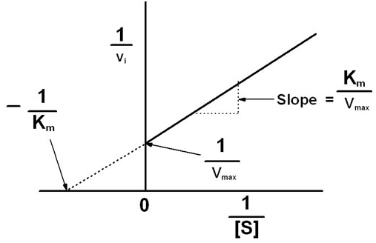
If [S]= ∞, then:
1
= 0, now:
[S]
1
1
=
v
V_{max}
1
Ha
= 0 (possible only in teory!), than:
v
K_{m}
1
1
1
1
·
=
= -
V_{max}
[S]
V_{max}
[S]
K_{m}
The linear determines K_{m} and V_{max}

Slide 30
Turnover number: the quotient of v_{max} and the concentration of the enzyme
k_{cat}= v_{max}/E₀ (its value is between 1 and 10 000, generally ~ 1000)
The number of converted substrate molecules in a second by one enzyme molecule.
K_{M}:
It gives the concentration of substrate in the surrounding space of the enzyme.
It is constant for a certain enzyme. It can be applied for the recognition of the enzyme.
It can be influenced by different compound to regulate the activity of the enzyme.
It gives the affinity of substrate for the enzyme

Slide 31
Enzymes
Activity of an enzyme (v): During a given time (min. or sec)
how much substrates (μmol) transfosrms to products
(Unit: μmol/min) (Catal: mol/sec)

Slide 32
Enzyme inhibitors
Enzyme inhibitors are molecules that interfere with catalysis, slowing or halting enzymatic reactions.
Reversible and Irreversible
Irreversible inhibition: The irreversible inhibitors bind covalently with or destroy a functional group on an enzyme that is essential for the enzyme’s activity, or form a particularly stable noncovalent association (e.g.: heavy metals). An irreversible inhibitor decrease the real amount of an active enzyme.
Reversible inhibition: The reversible inhibitors form dynamic complex with the enzyme.

Slide 33
Reversible inhibition: It has 3 different types
Competitive inhibitor: It competes with the substrate for the active site of an enzyme. The K_{M} increase
Uncompetitive inhibitor: An uncompetitive inhibitor binds at a site distinct from the substrate active site and, unlike a competitive inhibitor, binds only to the ES complex. v_{max}, K_{M} decrease
Mixed inhibitor: also binds at a site distinct from the substrate active site, but it binds to either E or ES. v_{max} decrease

Slide 34
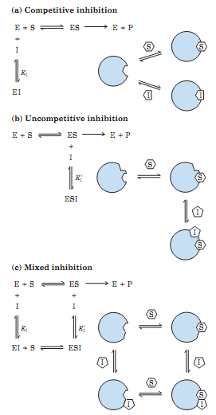

Slide 35
velocity
velocity
Concentration of substrate
Concentration of substrate
Competitive inhibition:
v_{max} same, K_{M} increase
Mixed inhibition:
v_{max} decrease, K_{M} same
Uncompetitive inhibition:
v_{max} decrease K_{M} decrease
velocity
Concentration of substrate

Slide 36
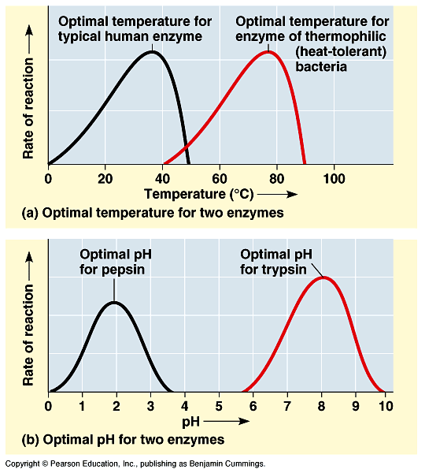
Enzyme activity depends on the pH and on the temperature
Heat denaturation
velocity
Arhenius
temperature

Slide 37
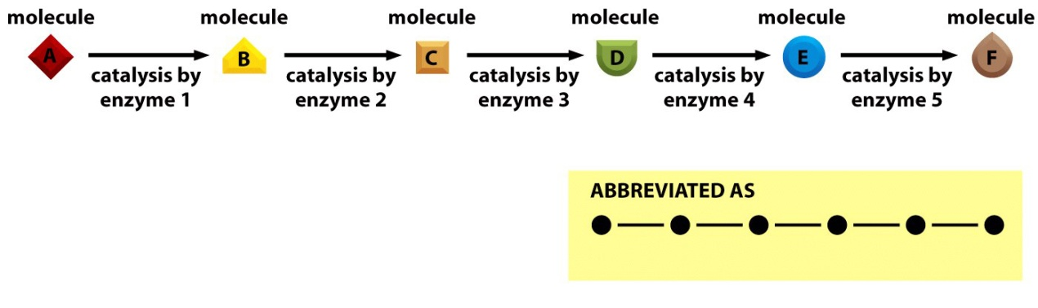
Enzyme-catalyzed reactions are usually connected in series
The product of one reaction becomes the starting material, or substrate, for the next.
Each pathway includes one or more enzymes that have a greater effect on the rate of the overall sequence.
These regulatory enzymes exhibit increased or decreased catalytic activity in response to certain signals.
Adjustments in the rate of reactions catalyzed by regulatory enzymes allow the cell to meet changing needs for energy and for biomolecules required in growth an maintenance.

Slide 38
Mechanisms of regulation of enzymes
Allosteric
feedback inhibition
precursor activation
Covalent modification (phosphate groups)
  protein kinases, phosphatases
Limited proteolysis (zymogenes)
  serine proteases, inhibítors

Slide 39
Enzymes are classified by the reactions they catalyze
Class no. | Class name | Type of catalyzed reaction
1 | Oxidoreductases | Transfer of electrons (hydride ions or H atoms)
2 | Transferases | Group transfer reactions
3 | Hydrolases | Hydrolysis reactions (transfer of functional groups to water)
4 | Lyases | Addition of groups to double bonds, or formation of double bonds by removal of groups
5 | Isomerases | Transfer of groups within molecules to yield isomeric forms
6 | Ligases | Formation of C-C, C-S, C-O, and C-N bonds by condensation reactions coupled to cleavage of ATP or similar cofactor

Slide 40
Classifying the enzymes
Oxidoreductases (important subfamilies)
Transferases (function groups transfer)
Hydrolases (cleavage by water)
Lyases (addition or elimination of smaller groups)
Ligases (ligating two molecules by using energy)
Isomerases (rearranging functional groups)

Slide 41
Izoenzymes
Same substrate, same biochemical reaction
Different primary proteine-structure
They can also differ:
regulation
compartmentalization inside the cell
distribution in different organs and cell types
reaction kinetics
affinity to different substrates
specificity

