Slide 1
Lipid metabolism
2016
Lívius Wunderlich

Slide 2
Lipids
Fats and oils
Hydrophobic feature
Energy storage, cell membrane,
some hormones, detergents, vitamins
Triglycerides, phospholipides,
steroids, eikosanoids

Slide 3
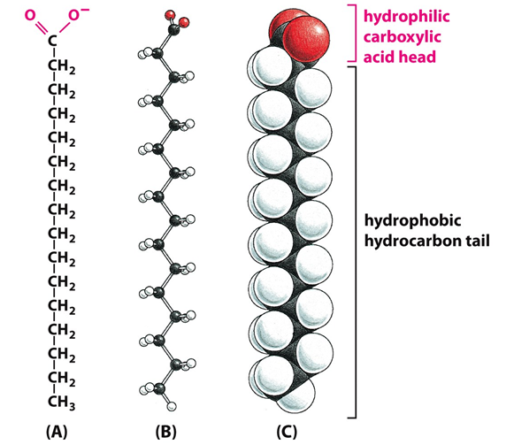
Fatty acids

Slide 4
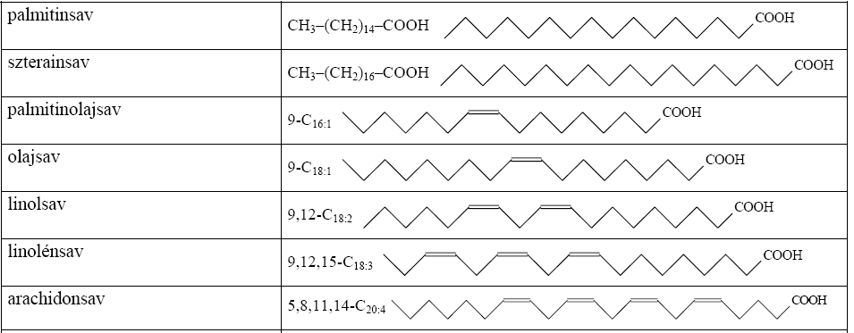
Most important fatty acids
palmitic acid
stearic acid
palmitoleic acid
oleic acid
linolic acid
linoleic acid
arachidonic acid

Slide 5
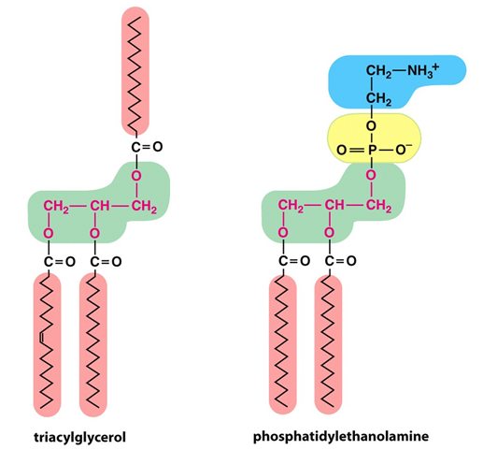
Triglycerides, glycerophospholipides

Slide 6
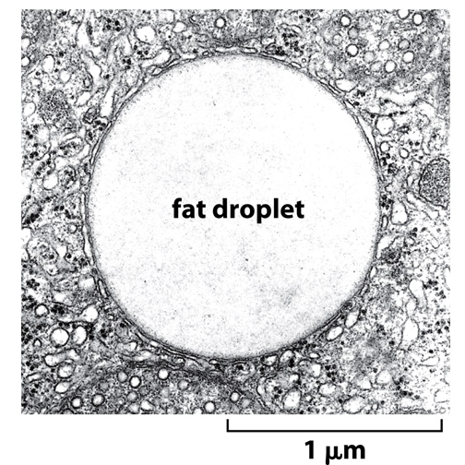
Triglyceride storage

Slide 7
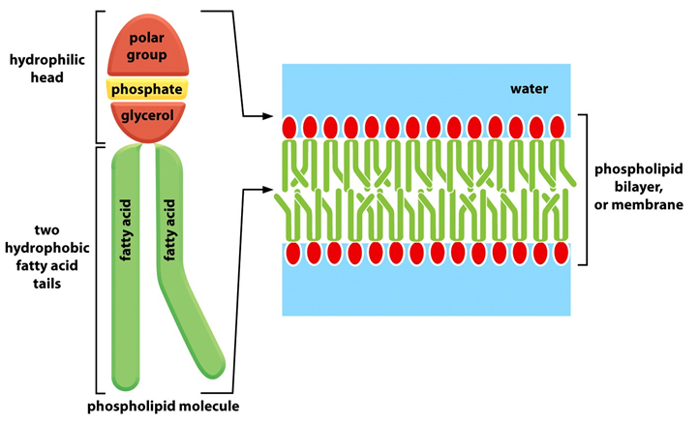
Phospholipide membrane

Slide 8
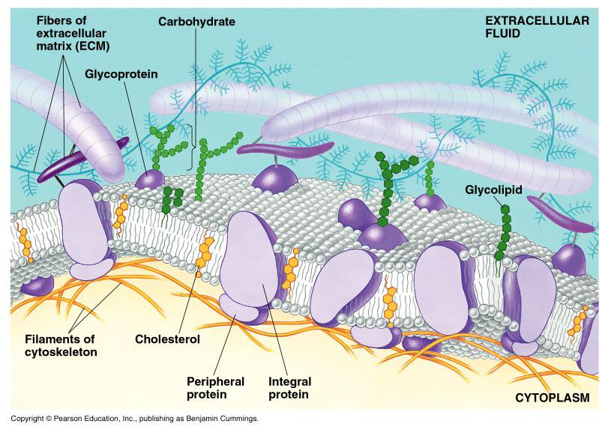
Phospholipide membrane

Slide 9
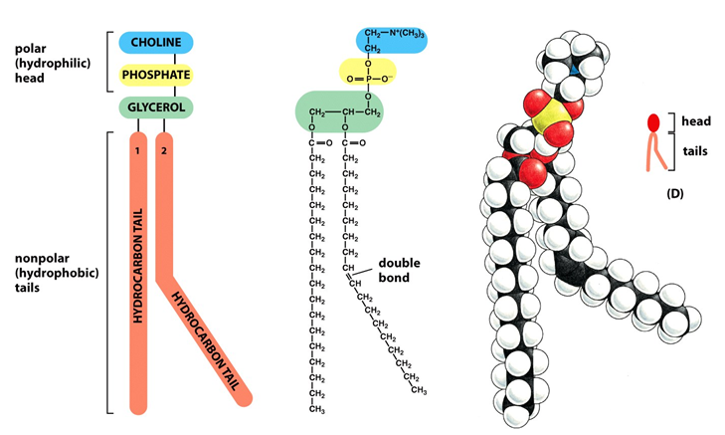
Unsaturated phospholipide configuration matters!

Slide 10
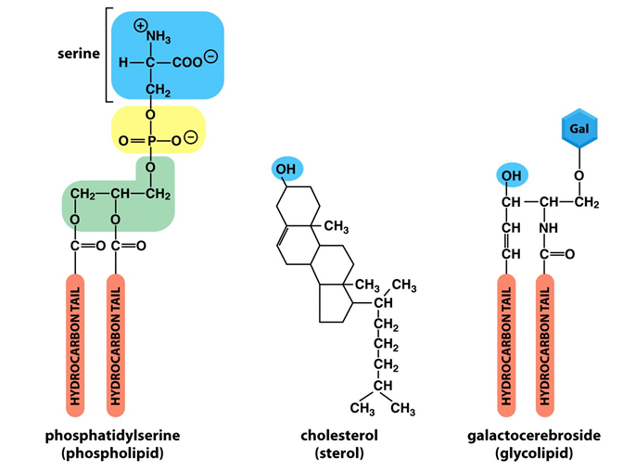
Some membrane components

Slide 11
Digestion of lipids
Hydrolase enzymes
Lingual and gastric lipases work in the stomach:
Slow process
Intestinum: bile acids, colipases,
pancreatic lipases activtaed by trypsin
Trigliceride-esterases, phospholipases
cholesterol-estarases
Resulting:
Free fatty acids, colesterol, monoacyl-glycerols
glycerol phosphatides

Slide 12
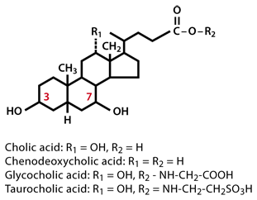
Structure of bile acids

Slide 13
Enterohepatic circulation of bile acids
Liver
Primary bile acids
cca. 90 %
reabsorbed
Deconjugation and dehydroxy-
lation by bacteria
Gall
bladder
Colon
Secondary bile acids

Slide 14
cholesterol esterases
cholesterol
fatty acids
monoacyl-glicerides
pancreatic lipases

Slide 15
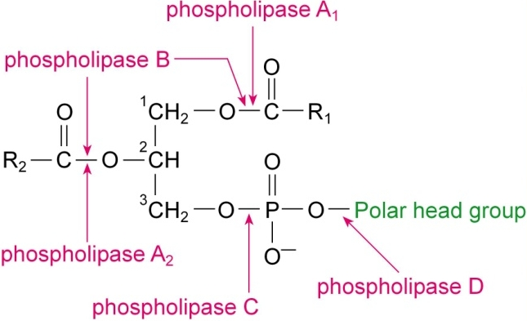
Phospholipases

Slide 16
Th fate of digested lipids
Absorbtion of digested lipids to epithelial cells
Re-assembling most of them, resulting triglicerides,
phospholipides, cholesterin-esters
Non-reassembled fatty acids enter the blood vessels,
binding to serum albumin
Re-assembled lipids, free cholesterol and apoproteins
form lipoprotein micelles called nascent chylomicrons
Nascent chylimicrons enter the lymphatic system, then
the blood avoiding vena portae hepatis

Slide 17
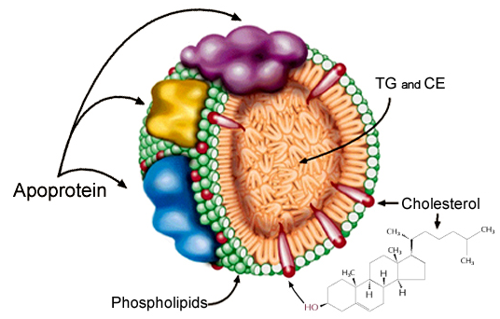

Slide 18
The chylomicron’s fate
liver
intestine
endocytosis
ApoE
receptor
Y
HDL
ApoC
ApoC, ApoE
nascent
chylomícron
chylomicron
remnant
ApoE
mature
chylomicron
ApoC
ApoE
ApoC
capillary
Y
LPL
adipose tissue
striped muscle,
heart muscle
fatty acids

Slide 19
The fate of VLDL
liver
endocytosis
VLDL
ApoE
receptor
ApoB100
Y
peripheral
tissues
ApoB100
receptor
ApoE
hepatic lipase
Y
Y
endocytosys
HDL
fatty acids
ApoC, ApoE
ACAT
ApoC
VLDL
ApoE
ApoB100
IDL
LDL
ApoE
ApoB100
ApoB100
ApoC
capillary
Y
fatty acids
LPL
adipose tissue
striped muscle,
heart muscle

Slide 20
The roles of HDL
liver
endocytosis
nascent
HDL
fatty acids
intestine
cholesterol
peripheral
tissues
triglicerides
VLDL
LCAT
HDL
ApoC, ApoE,
cholesterol-esters
cholesterol
phospholipids
ApoC
ApoE
chylomicron

Slide 21
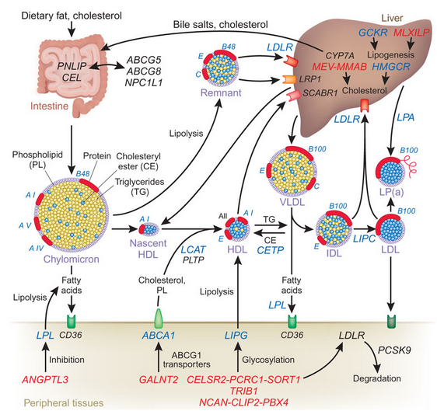

Slide 22
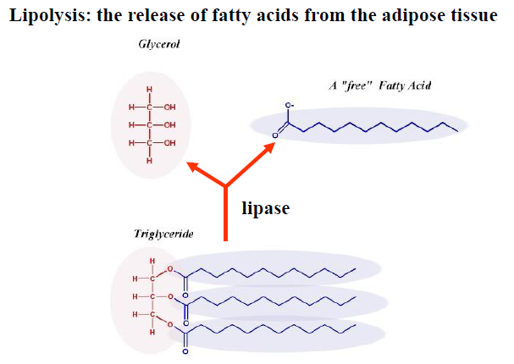

Slide 23
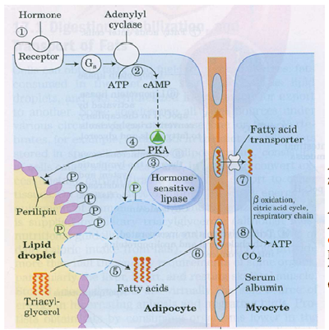
The mobilisation of lipid storages

Slide 24
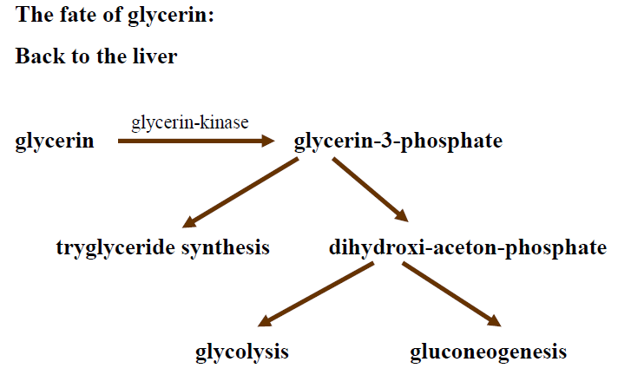

Slide 25
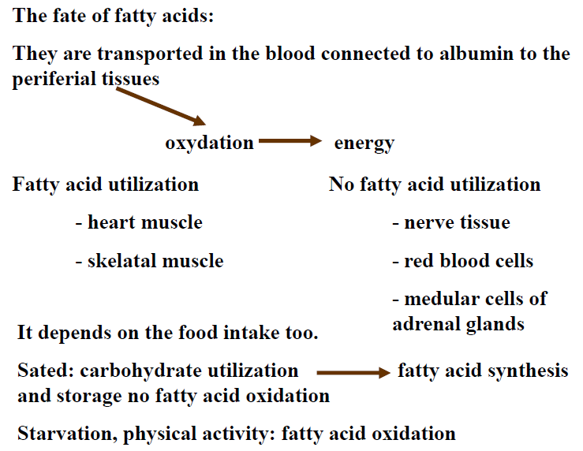

Slide 26
Activating of fatty acids
+
+
ATP
+
H₂O
+
AMP
+
2 P_{i}

Slide 27
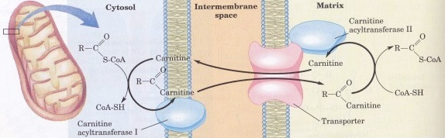
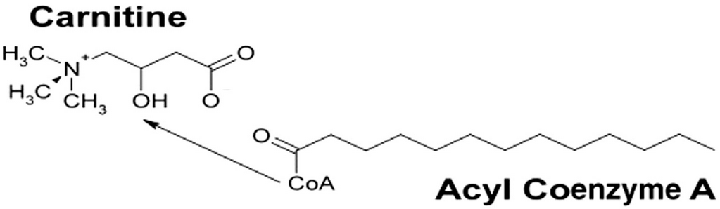
Transport to the mitochondrion

Slide 28
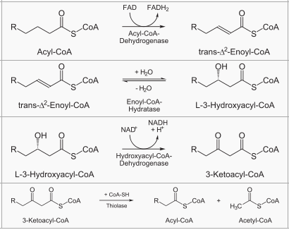
β-oxydation

Slide 29
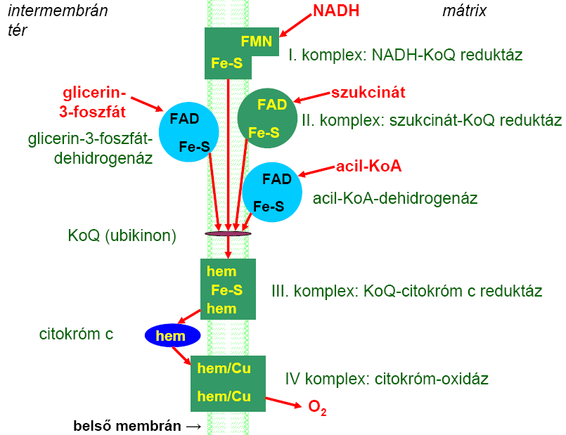

Slide 30
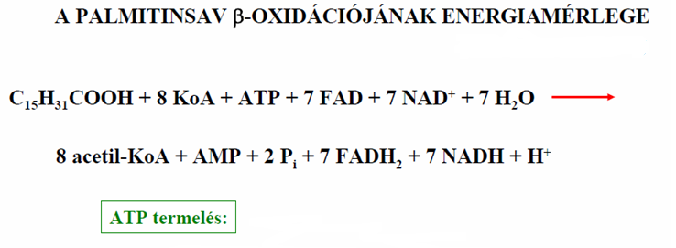
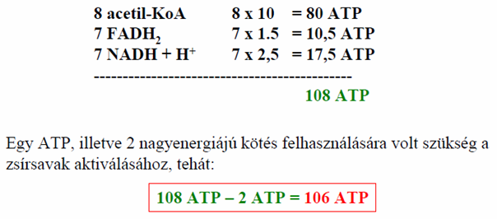
Energy-balance of β-oxydation
ATP production:
Since the energy of 2 ATPs were used for activation:

Slide 31
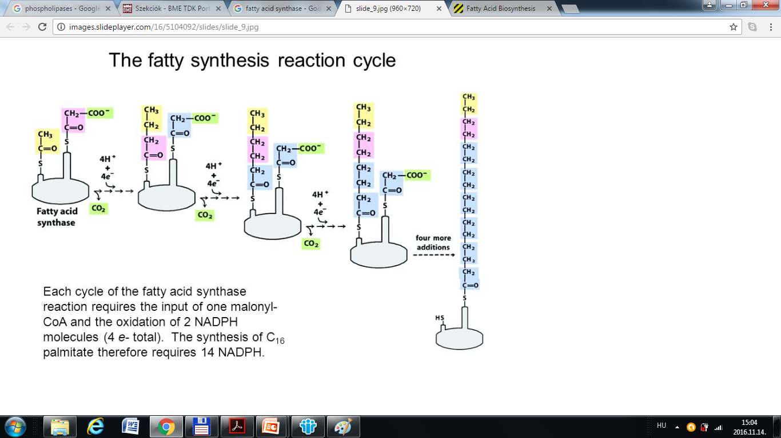

Slide 32
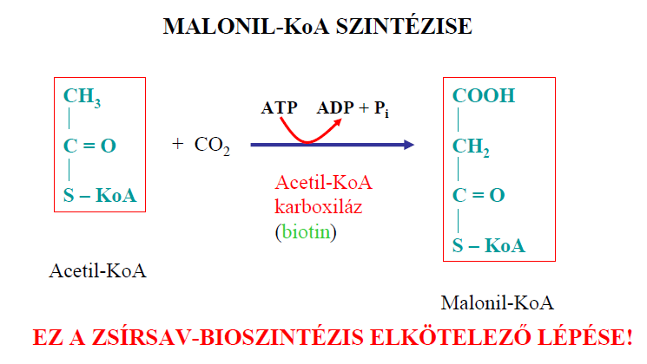
Fatty acid sythesis: producing malonyl-Coa
Acetyl-Coa
carboxylase
acetyl-Coa
malonyl-Coa
This is the engaging step of fatty acid synthesis!

Slide 33
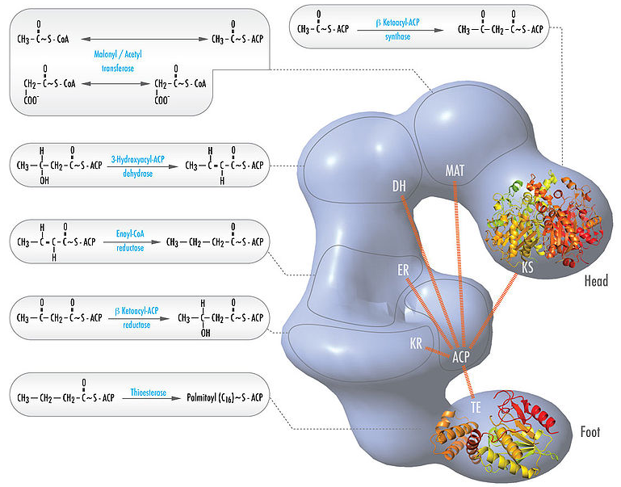
A zsírsav szintáz felépítése, működése

Slide 34
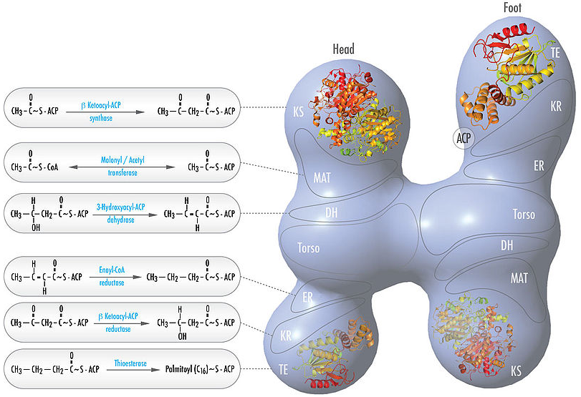

Slide 35
